Slide 1

Portsdown Primary School and Early Years
Welcome to our new Reception Parents
2025-2026

Slide 2

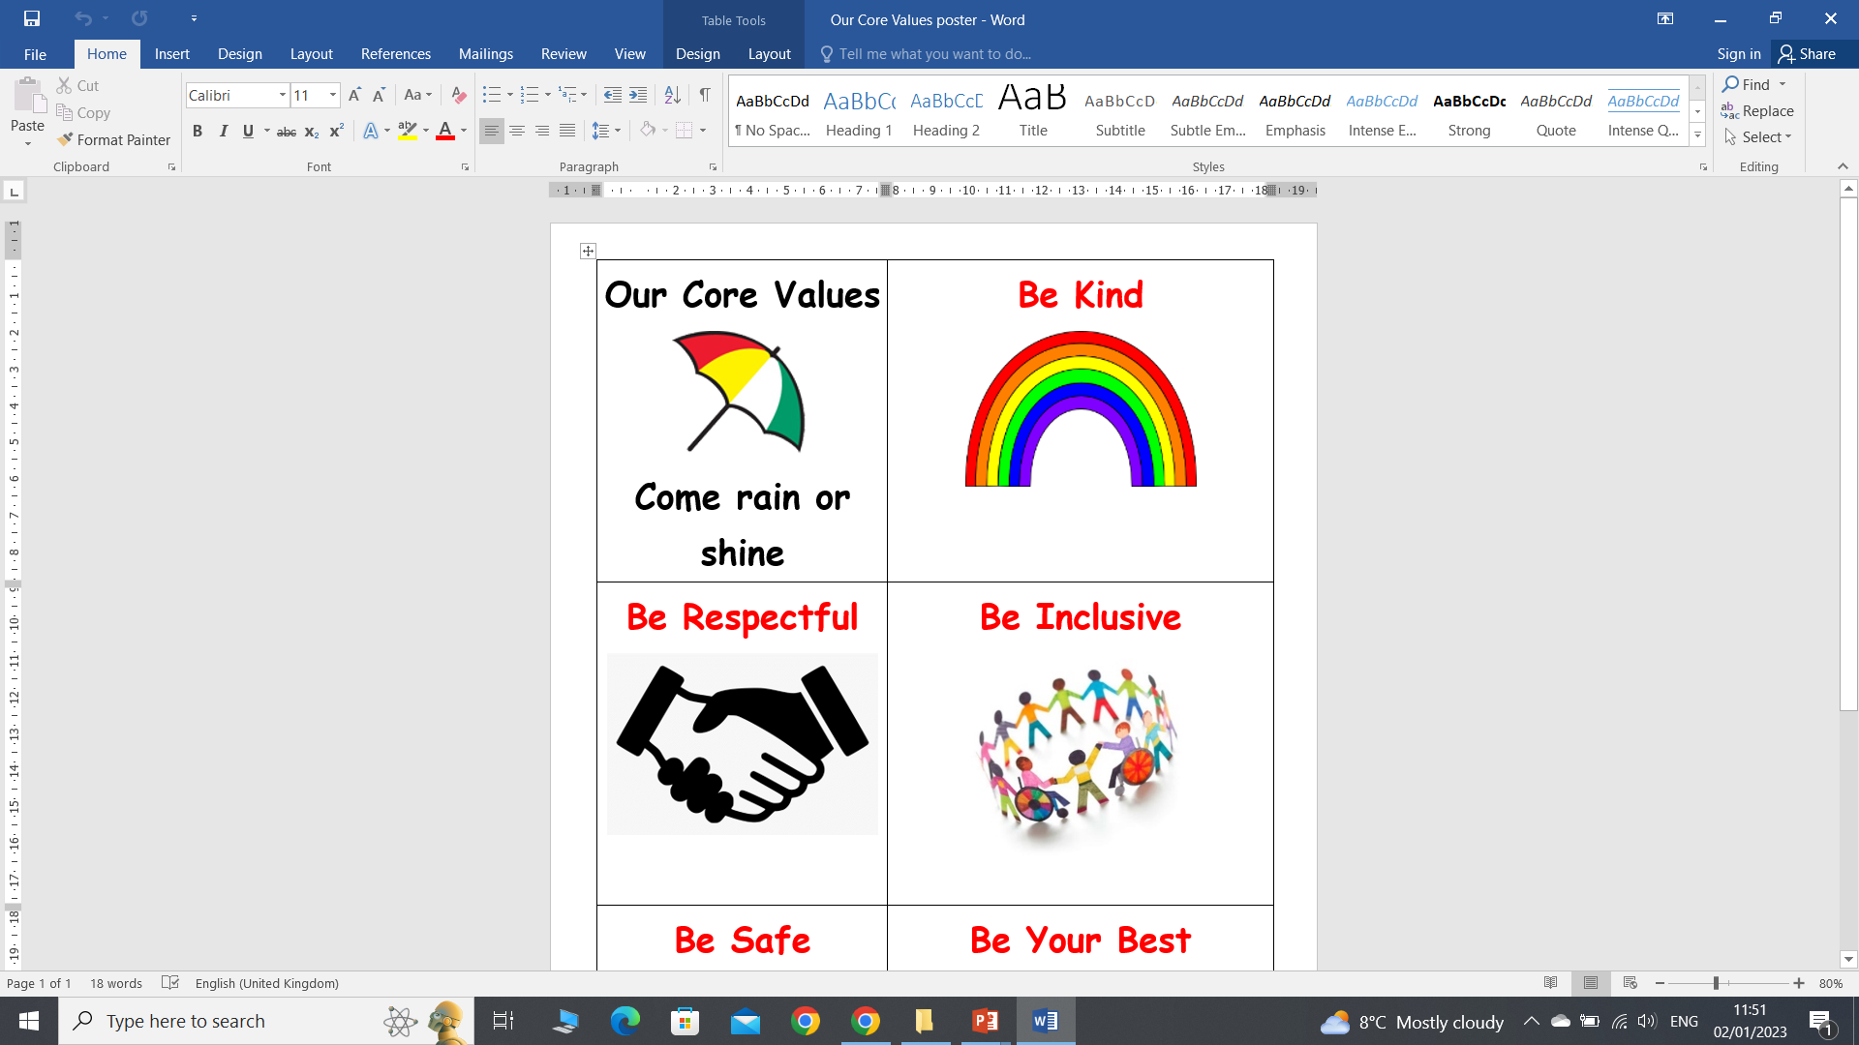
Our school values

Slide 3
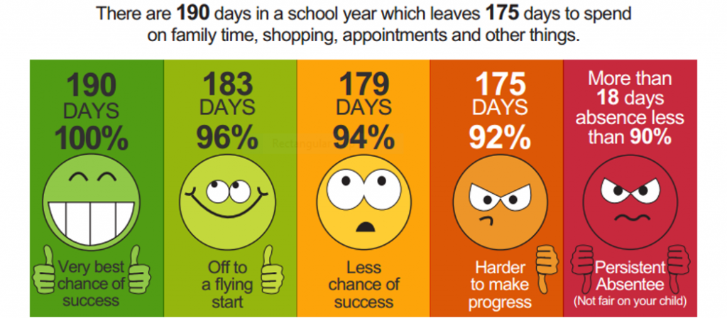
Attendance

Slide 4


Phonics and reading
We begin phonics right from the start.
We follow the Little Wandle phonics scheme
Children will initially come home with a book without words
We encourage children to read their books at least 4 times a week.
Children in Reception regularly visit Cosham Library

Slide 5
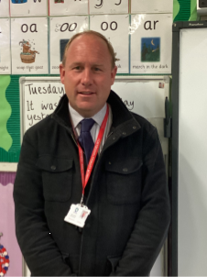
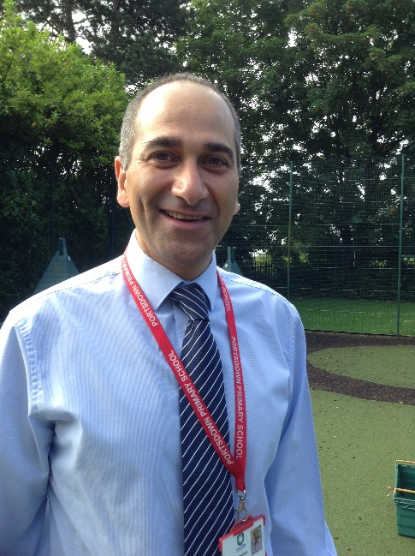
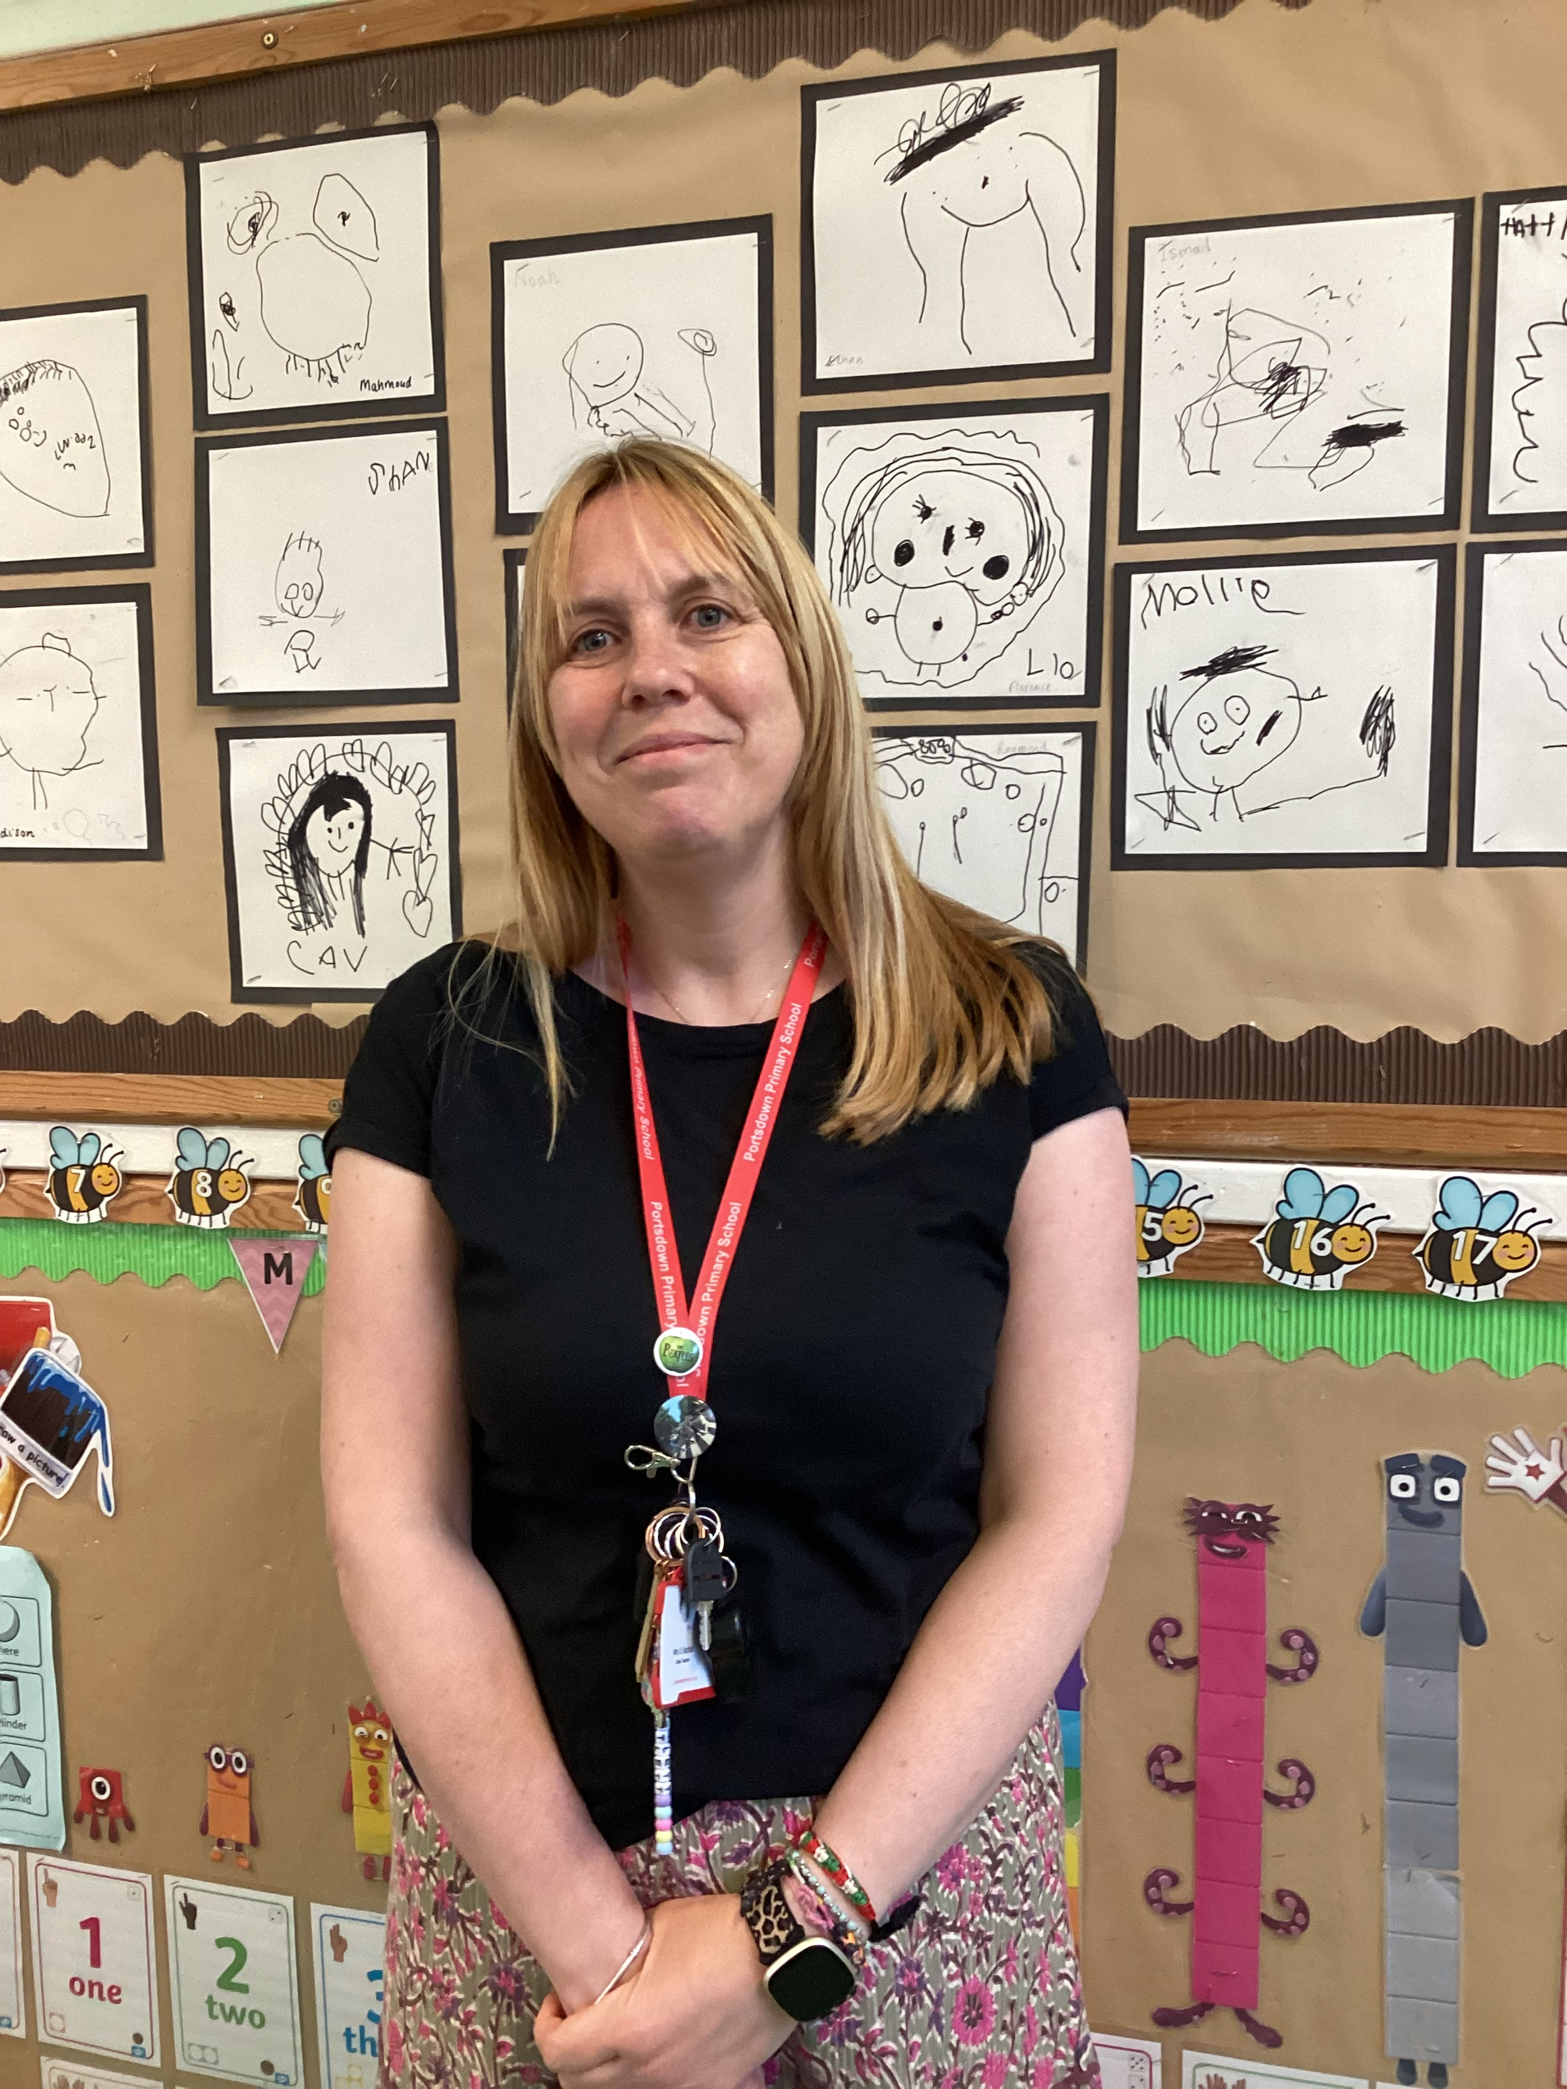
Meet the team
SENCO
Mr Vaghela
Mr Cowell
Mrs Bartlett
Mrs Ludlow
There are two classes in Reception.
Bumblebees and Snails class
Each class will have a teaching assistant to support

Slide 6

The school day
Door open at 8.45 am
School finishes at 3.15pm
The children are dropped off and picked up from outside the classroom doors.
If you are late please enter school through the main school entrance where you can sign your child in.

Slide 7
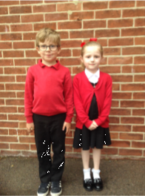

School uniform
Our uniform
White shirt or white polo shirt
Black or grey trousers, shorts pinafore dress or skirt
Easy to fasten black shoes that are safe to run and climb in
Red sweatshirt, jumper or cardigan
A warm coat in the winter and sun hat in the summer
PE Kit
Plain white t –shirt, black shorts and plimsolls or trainers for PE
Drawstring bag
PLEASE NAME EVERYTHING

Slide 8

Healthy snacks
  The children are provided with a piece of fruit everyday. They have this in the morning and everyone has the same snack.
  Milk is also available for children at snacktime.
  The children are encouraged to drink water throughout the day. All children in Reception are provided with a water bottle.

Slide 9
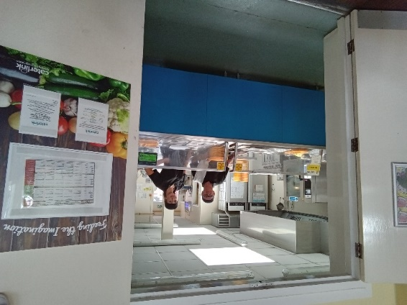
Lunchtimes
Children have the choice of school dinners or bringing in a packed lunch
All Reception children and children in Year 1 and 2 are entitled to a free school meal everyday.
There are 3 choices each day, which always includes a vegetarian option.
They can be ordered online using the scopay app or your child can choose in class in the morning.

Slide 10
Learning in the Early Years
At Portsdown we follow the revised Early Years Foundation Stage Curriculum, following play based learning approach. This builds on the work that your child has done in pre-school.
This provides a wide range of activities, including adult led and child-initiated learning.
This includes activities that support:
Personal, social and emotional development
Communication and language development
Physical development
Literacy
Maths development
Understanding the World
Expressive Arts and Design

Slide 11
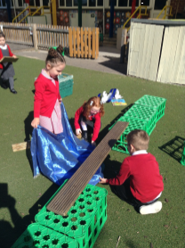
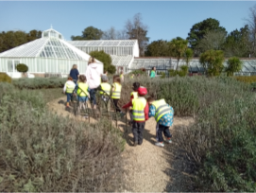
A typical day in Reception
The children are taught through a mixture of play based learning and structured learning—Phonics (Reading and Writing) and Maths
Stories and rhymes are a regular part of each day
Other experiences include trips and visitors, e.g. Cosham library, Staunton farm and music workshops
There is a greater emphasis on working outside so your child needs to be dressed appropriately for the weather

Slide 12

How can you help?
  Dress independently
  Use the toilet and wash hands without help
  Share lots of stories with your child and ensure there is plenty of talk
  Sing simple songs and rhymes
  Practise fine motor skills such as cutting and pencil grip
  Recognise and write their name
www.portsmouth.gov.uk/startschooltips

Slide 13
Breakfast club and after school club
Breakfast club
Children are provided with a healthy breakfast, e.g. cereal or toast. Children then have opportunity to play supervised games
Arrival time 8 – 8.20
Booking essential
Speak to front office to register
Morning session fee is £2
Farlington Wrap Around Care
Farlington Wrap Around run an after school club here in school for children aged 3 to 11.
offer regular and flexible childcare sessions for £12.50* per afternoon for childcare from when school finishes until 6pm, this also includes a light tea.
*an extra fee of £1 is charged for flexi sessions.
Check out their website for more information

Slide 14
Transition dates
Stay and play:
In the weeks beginning: 16th June and 23rd June
Home visits:
During July
School part time: Thursday 4th September
Friday 5th September
8.45 – 11.30 am
12.30 – 3.15 pm
Children will attend 2 half day sessions in small groups. We will let you know which sessions your child will attend.
Full time : All children will be full time from Monday 8thSeptember

Slide 15
And finally!
We hope that this presentation is useful. Should you have any questions, please feel free to speak to a member of staff.
We look forward to working with both you and your children.
Remember to collect your information pack
Sign and return the necessary forms
Keep talking to us
Relax and enjoy the next stage of your child’s development

